Slide 1

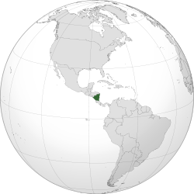

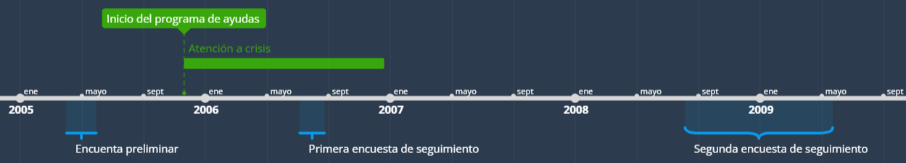









Tratamientos: ayudas a la unidad familiar
Pago por un valor de ~ 15% del gasto medio per capita
Formación/divulgación sobre la importancia de hábitos saludables, educación, etc.
T1
Entregado al cuidador principal de los hijos (en su mayoría, a la madre)
Con una frecuencia bimestral
T2
Curso de formación vocacional/profesional
T1
Beca para el desarrollo de una actividad económica no agrícola

Slide 2


Baseline
comprehensive information on household socioeconomic status, including detailed expenditure modules,
extensive information on child health and nutrition, including child height and weight, and one measure of child cognitive development, the TVIP
Follow-up
assess child development. Social-personal, language, fine motor, and gross motor skills for all children using the four sub-scales of the Denver Developmental Screening Test
For children age 36 months and older, we applied five additional tests. The first of these is the TVIP. We also use a short-term memory test from the McCarthy test battery
test of leg motor development from the McCarthy test battery
The final test we use is the Behavior Problem Index (BPI),
The two follow-up surveys also include information on stimulation, birthweight, preventive health care, and caregivers' mental health.
Finally, caregivers' observed parenting behavior was registered through a shortened version of the HOME score

